Slide 1

iOS Programing with Swift (Part II)
CSIE, National Dong Hwa University
Shou-Chih Lo
2021

Slide 2

Reference Book
Beginning iOS 14 Programming with Swift, Simon Ng: https://www.appcoda.com/swift/
iOS App程式開發實務攻略：快速精通iOS 14程式設計, Simon Ng: 博碩文化股份有限公司

Slide 3
Simple Table Based App
Chapter 8

Slide 4
Table Based App
A list of restaurant names with images
View Controller + Table View object
Delegation patterns
Project Name: SimpleTable

Slide 5
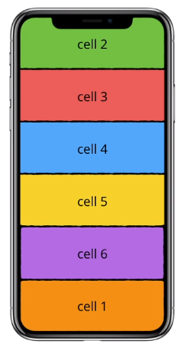
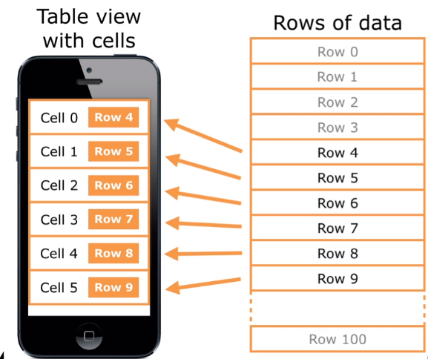
Table Based App
Recycled Cells (retrieved by a cell identifier)

Slide 6
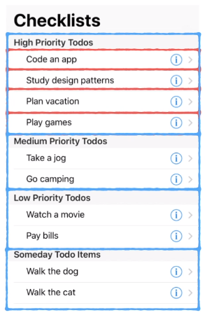
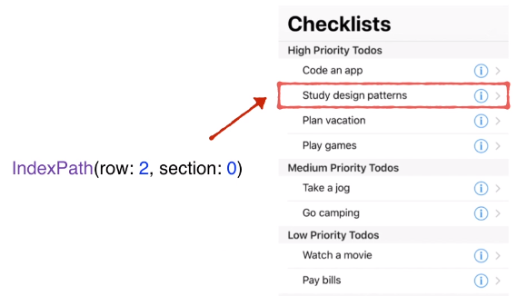
Table Based App
Section and Row
section header
4 sections
1

Slide 7
Add Table Views
Drag a Table View
Resize the table view to fit the whole view
The number of Prototype Cells to 1
Cell style to Basic
Identifier to datacell (which will be used in program codes)
Table spacing: all to 0, Constrain to margins option is unchecked

Slide 8
Provide Operation Codes
Select Table View, and check the class name: UITableView
ViewController.swift > append UITableViewDataSource, UITableViewDelegate protocols

Slide 9
Provide Operation Codes
Delegation Pattern

Slide 10
Provide Operation Codes
Click the Fix button in the error prompt in the code editor area
Provide an array to store restaurant names (source of table data)
Notes:
var restaurantNames = ["Cafe Deadend", "Homei", "Teakha", "Cafe Loisl", "Petite Oyster", "For Kee Restaurant", "Po's Atelier", "Bourke Street Bakery", "Haigh's Chocolate", "Palomino Espresso", "Upstate", "Traif", "Graham Avenue Meats And Deli", "Waffle & Wolf", "Five Leaves", "Cafe Lore", "Confessional", "Barrafina", "Donostia", "Royal Oak", "CASK Pub and Kitchen"]

Slide 11
Provide Operation Codes
Two required methods of the UITableViewDataSource protocol
Called for each section
Called for each cell
Notes:
let cellIdentifier = "datacell"
let cell = tableView.dequeueReusableCell(withIdentifier: cellIdentifier, for: indexPath)
// Configure the cell...
cell.textLabel?.text = restaurantNames[indexPath.row]
return cell

Slide 12
Connect DataSource and Delegate
Tell the UITableView object that ViewController is the delegate object for the data source
Control-drag from the table view
to the View Controller, and select dataSource
Repeat again and select delegate

Slide 13
Connect DataSource and Delegate
Show these connections
Connections inspector or right-click the table

Slide 14
Add Thumbnail to Table View
Drag the images to the asset catalog
Notes:
cell.imageView?.image = UIImage(named: “restaurant”)

Slide 15
Hide the Status Bar
ViewController.swift

Slide 16
Summary
Add an identifier name (to be reused ID) to the prototype cell
Conform UITableViewDataSource and UITableViewDelegate protocols
Do the connections for the above two protocols
Provide the implementations of the needed methods
A table view can occupy the whole or part of the screen

Slide 17
Customize Table Views Using Prototype Cell, UITableViewDifferableDataSource
Chapter 9

Slide 18
FoodPin App
Use UITableViewController (with default TableView)
Occupy the whole screen
Without manually configure any delegations
Display a distinct image for each restaurant
Design a custom table view cell
Project Name: FoodPin

Slide 19
UITableViewController
Delete ViewController in the storyboard
Delete ViewController.swift
Drag a Table View Controller
Tick the Is Initial View Controller option (arrow pointing to the table view controller)
(We need a swift file associated to this controller)
(UITableViewController already adopts and connects to two delegation protocols)

Slide 20
UITableViewController
Right-click the FoodPin folder and select "New Files...“ > Cocoa Touch Class
Class name: TableViewController
"Subclass of" to UITableViewController
Set the custom class to TableViewController
Change the prototype cell style to Basic and set the identifier to datacell

Slide 21
Using UITableViewDataSource
Set the number of section and the number of rows in section

Slide 22
Using UITableViewDataSource
Notes:
let cellIdentifier = "datacell"
let cell = tableView.dequeueReusableCell(withIdentifier: cellIdentifier, for: indexPath)
// Configure the cell...
cell.textLabel?.text = restaurantNames[indexPath.row]
cell.imageView?.image = UIImage(named: “restaurant”)
return cell

Slide 23
Using UITableViewDiffableDataSource
UITableViewDataSource: provide the method implementations about what cell to display, how many cells to display, which section to display the cells in, and so on
UITableViewDiffableDataSource: provide the method implementations about what sections and items to display.
Each item should have the unique identifier
If the identifier is the whole item itself, duplicated items crash the app

Slide 24
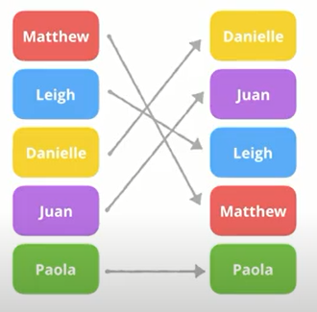
Using NSDiffableDataSourceSnapshot
NSDiffableDataSourceSnapshot stores your sections and items, which the diffable data source references to understand how many sections and cells to display.
Old snapshot
New snapshot
Set of item’s identifiers to be displayed
Compare the differences based on hashValues (Automatic data change animations)

Slide 25
Create the Data Source Object
func configureDataSource() -> UITableViewDiffableDataSource<Section, String> {
let dataSource = UITableViewDiffableDataSource<Section, String>(
tableView: tableView,
cellProvider: { tableView, indexPath, restaurantName in
let cell = tableView.dequeueReusableCell(withIdentifier: "datacell", for: indexPath)
cell.textLabel?.text = restaurantName
…
return cell
}
)
return dataSource
}
Item identifier type
Notes:
// MARK: - UITableView Diffable Data Source
func configureDataSource() -> UITableViewDiffableDataSource<Section, String> {
let cellIdentifier = "datacell"
let dataSource = UITableViewDiffableDataSource<Section, String>(
tableView: tableView,
cellProvider: { tableView, indexPath, restaurantName in
let cell = tableView.dequeueReusableCell(withIdentifier: cellIdentifier, for: indexPath)
cell.textLabel?.text = restaurantName
cell.imageView?.image = UIImage(named: "restaurant")
return cell
}
)
return dataSource
}

Slide 26
Provide Program Codes
Declare the section type as Enum
enum Section { //suppose one section only
case all
}
Declare the data source variable
lazy var dataSource = configureDataSource()
Notes:
enum Section { //suppose one section only
case all
}
lazy var dataSource = configureDataSource()

Slide 27
Provide Program Codes
Set the data source to the tableView and create a snapshot
override func viewDidLoad() {
…
tableView.dataSource = dataSource
//Create the snapshot
var snapshot = NSDiffableDataSourceSnapshot<Section, String>()
snapshot.appendSections([.all])
snapshot.appendItems(restaurantNames, toSection: .all)
dataSource.apply(snapshot, animatingDifferences: false)
}
Notes:
tableView.dataSource = dataSource
//Create the snapshot
var snapshot = NSDiffableDataSourceSnapshot<Section, String>()
snapshot.appendSections([.all])
snapshot.appendItems(restaurantNames, toSection: .all)
dataSource.apply(snapshot, animatingDifferences: false)

Slide 28
Display Different Thumbnails
Drag all the images into the asset catalog
Change the code
cell.imageView?.image = UIImage(named: self.resraurantImages[indexPath.row])
Notes:
var restaurantImages = ["cafedeadend", "homei", "teakha", "cafeloisl", "petiteoyster", "forkeerestaurant", "posatelier", "bourkestreetbakery", "haighschocolate", "palominoespresso", "upstate", "traif", "grahamavenuemeats", "wafflewolf", "fiveleaves", "cafelore", "confessional", "barrafina", "donostia", "royaloak", "caskpubkitchen"]

Slide 29
Customize Table Cells
Change the prototype cell style to Custom, the row height to 140
Drag an Image View to the prototype cell
X=20, Y=10, Width=120 and Height=120, Content Mode: Aspect Fill

Slide 30
Customize Table Cells
Add three labels
Name: Text Styles = Title 2
Location: Text Styles = Body, font color = Dark Gray
Type: Text Styles = Subhead, font color = Dark Gray
Stack the above labels: spacing to 4

Slide 31
Customize Table Cells
Stack the image view and the stack view of labels, Spacing to 20 and top alignment
Margin: top, left, bottom and right sides to 0, 0, 0 and 0, Constraint to margins is checked
Image size is fixed: constraints on both "width" and "height"
Notes:
Constraint to margins is checked
Set the top and bottom priority < 1000 (cell may be deleted in the future)

Slide 32
Customize Table Cells
(Customized table cells need customized program codes to access embedded views)
"New File…". > "Cocoa Touch Class“ > TableViewCell, "Subclass of" : UITableViewCell
Set the custom class to TableViewCell

Slide 33
Connection Between UIs and Codes
TableViewCell.swift
@IBOutlet is used to indicate a property (or variable) that can be connected with a view object in a storyboard.
@IBAction is used to indicate an action method that can be triggered by a certain event on a view object
Implicitly unwrapped optional
Notes:
@IBOutlet var nameLabel: UILabel!
@IBOutlet var locationLabel: UILabel!
@IBOutlet var typeLabel: UILabel!
@IBOutlet var thumbnailImageView: UIImageView!

Slide 34
Connection Between UIs and Codes
Mapping between outlets and view objects

Slide 35
Connection Between UIs and Codes
Right click the cell in the Document Outline view
Drag from the circle to the view object

Slide 36
Updating the Table View Controller
TableViewController.swift
let cell = tableView.dequeueReusableCell(withIdentifier: cellIdentifier, for: indexPath) as! TableViewCell
//type downcasting
// Configure the cell...
cell.nameLabel.text = restaurantName
cell.thumbnailImageView.image = UIImage(named: self.restaurantImages[indexPath.row])
Question mark is not needed
Notes:
let cell = tableView.dequeueReusableCell(withIdentifier: cellIdentifier, for: indexPath) as! TableViewCell
// Configure the cell...
cell.nameLabel.text = restaurantName
cell.thumbnailImageView.image = UIImage(named: self.restaurantImages[indexPath.row])
//cell.locationLabel.text = self.restaurantLocations[indexPath.row]
//cell.typeLabel.text = self.restaurantTypes[indexPath.row]

Slide 37
Circular Image
Every view in the UIKit (e.g. UIView , UIImageView ) is backed by an instance of the CALayer class (i.e. layer object)
The layer object provides various attributes about:
Background color
Border and border width
Shadow color, width, etc
Opacity
Corner radius

Slide 38
Circular Image (Option 1)
TableViewCell.swift
property observer
set to 20
Notes:
@IBOutlet var thumbnailImageView: UIImageView! {
didSet {
thumbnailImageView.layer.cornerRadius = thumbnailImageView.bounds.width / 2
thumbnailImageView.clipsToBounds = true
}
}

Slide 39
Circular Image (Option 2)
Add button (+) in the User Defined Runtime
In the Drawing section, enable the Clip to Bounds option

Slide 40
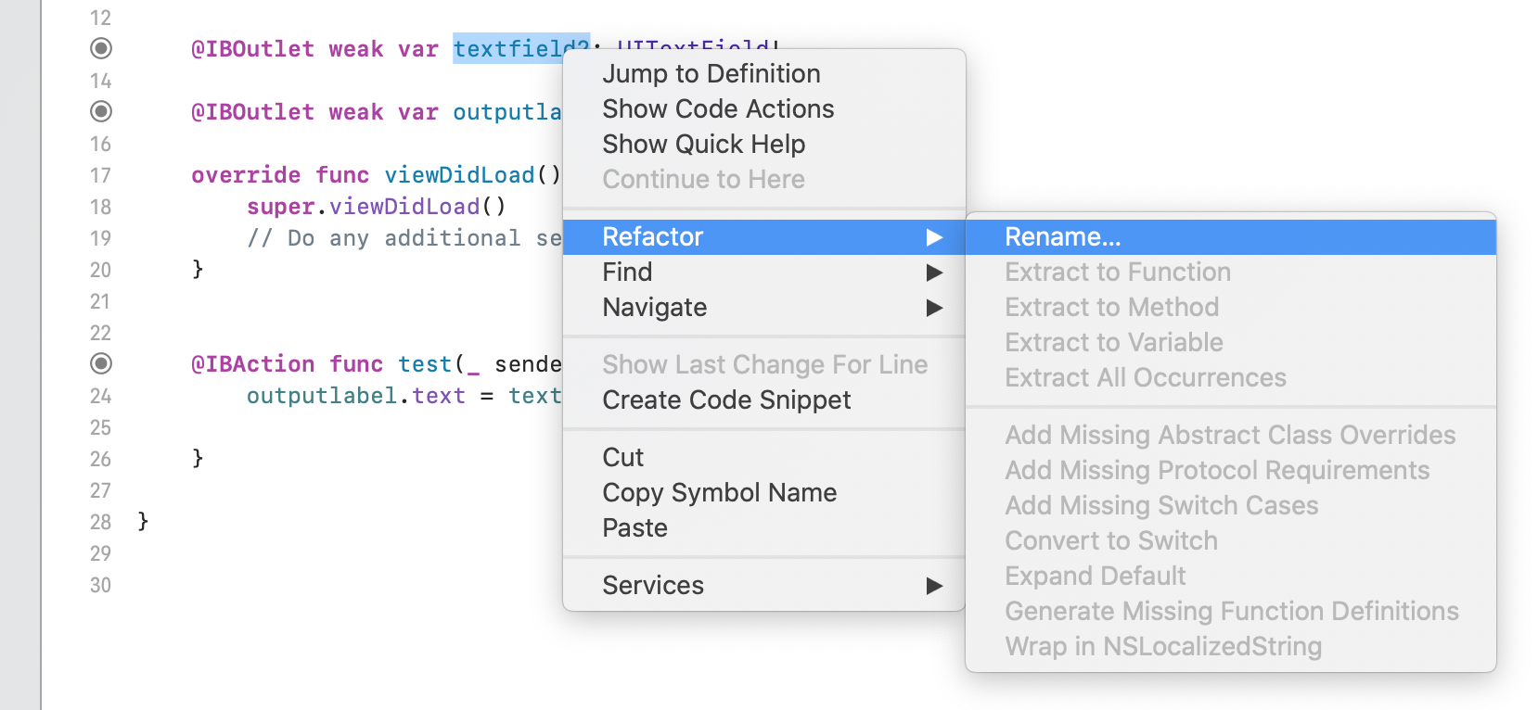
Rename after Connecting
You can safely change the name of an IBOutlet variable or an IBAction function through Refactor > Rename

Slide 41
Add More Information
Notes:
var restaurantLocations = ["Hong Kong", "Hong Kong", "Hong Kong", "Hong Kong", "Hong Kong", "Hong Kong", "Hong Kong", "Sydney", "Sydney", "Sydney", "New York", "New York", "New York", "New York", "New York", "New York", "New York", "London", "London", "London", "London"]
var restaurantTypes = ["Coffee & Tea Shop", "Cafe", "Tea House", "Austrian / Causual Drink", "French", "Bakery", "Bakery", "Chocolate", "Cafe", "American / Seafood", "American", "American", "Breakfast & Brunch", "Coffee & Tea", "Coffee & Tea", "Latin American", "Spanish", "Spanish", "Spanish", "British", "Thai"]

Slide 42
Summary
The table view controller is embedded with a table view that occupies the whole screen
The table view controller has conformed with the two needed protocols
UITableViewDiffableDataSource is a generic class conformed to the UITableViewDataSource Protocol
The cell identifier is still necessary
Switch to the Dark mode (after iOS 13): Xcode’s bottom toolbar > Environment Overrides > Appearance

Slide 43
Summary
Each view controller needs to be associated with a Cocoa Touch class file
Associate a protocol cell with a customized class file if the cell style is custom
The customized class file includes @IBOutlet declarations that connect to UI objects
tableView is an instance property that refers to the table view object

Slide 44
Exercise: Design Another Prototype Cell
Select Table View > Set Prototype Cells to 2
Select the second datacell, change the identifier to: favoritecell, set the Row Height to Automatic
Select the root stack view: Axis: Vertical, Alignment: Fill, Distribution: Equal Spacing, Spacing: 5
Delete the width’s constraint of the imageView, and set the height’s constraint to 200
Select the inner stack view: Layout Margin: Language Directional, Leading&Trailing: 20

Slide 45
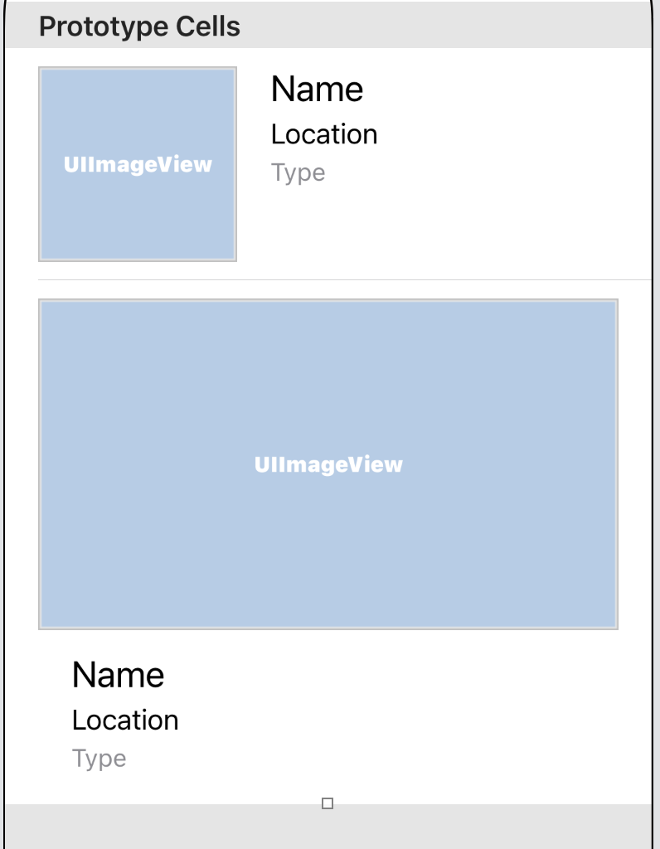
Exercise: Design Another Prototype Cell
TableViewController.swift
let cellIdentifier = “favoritecell”
Disable separator lines in the table view
tableView.separatorStyle = .none

Slide 46
Interacting with Table View and Using UIAlertController
Chapter 10

Slide 47
Interact with Table Views
Bring up a menu (action sheet) when a user taps a cell.
Display a check icon when a user selects Check-in

Slide 48
Through Delegation
UITableViewDataSource protocol defines methods for managing table data.
UITableViewDelegate protocol is responsible for handling cell selections and cell reordering
Accessing the API documentation
Hold the option key and click on the class name, or
Control-command-? and then place the cursor over a class or a protocol

Slide 49
Row Selection
Methods for managing row selections: Before and After

Slide 50
Row Selection
TableViewController.swift
Notes:
// MARK: - UITableView Delegate
override func tableView(_ tableView: UITableView, didSelectRowAt indexPath: IndexPath) {
// Create an option menu as an action sheet
let optionMenu = UIAlertController(title: nil, message: “What do you want to do?”, preferredStyle: .actionSheet)
// Add actions to the menu
let cancelAction = UIAlertAction(title: "Cancel", style: .cancel, handler: nil)
optionMenu.addAction(cancelAction)
// Display the menu
present(optionMenu, animated: true, completion: nil)
}
//UIAlertController.ActionSheet causes one constraint problem (ios bug)

Slide 51
Understand UIAlertController
Display alert messages
preferredStyle parameter: .actionSheet or .alert
Create UIAlertAction objects
Call addAction method
Present the alert message modally
action sheet
alert

Slide 52
Add Actions to the Alert Controller
// Add "Reserve a table" action
let reserveActionHandler = { (action:UIAlertAction!) -> Void in
let alertMessage = UIAlertController(title: "Not available yet", …)
alertMessage.addAction(UIAlertAction(title: "OK",…))
self.present(alertMessage, …)
}
let reserveAction = UIAlertAction(title: …, …, handler: reserveActionHandler)
optionMenu.addAction(reserveAction)
Notes:
// Add "Reserve a table" action
let reserveActionHandler = { (action:UIAlertAction!) -> Void in
let alertMessage = UIAlertController(title: "Not available yet", message: "Sorry, this feature is not available yet. Please retry later.", preferredStyle: .alert)
alertMessage.addAction(UIAlertAction(title: "OK", style: .default, handler: nil))
self.present(alertMessage, animated: true, completion: nil)
}
let reserveAction = UIAlertAction(title: "Reserve a table", style: .default, handler: reserveActionHandler)
optionMenu.addAction(reserveAction)

Slide 53
Action Handler
Specify a block of code (closure) as a handler

Slide 54
Add Actions to the Alert Controller
// Mark as favorite action
let favoriteAction = UIAlertAction(title: …, handler: { (action:UIAlertAction!) -> Void in
let cell = tableView.cellForRow(at: indexPath)
cell?.accessoryType = .checkmark
})
optionMenu.addAction(favoriteAction)
Return the selected cell (optional type)
Notes:
// Mark as favorite action
let favoriteAction = UIAlertAction(title: "Mark as favorites", style: .default, handler: {
(action:UIAlertAction!) -> Void in
let cell = tableView.cellForRow(at: indexPath)
cell?.accessoryType = .checkmark
})
optionMenu.addAction(favoriteAction)

Slide 55
Deselect Row
At the end of tableView(_:didSelectRowAt:)
This cell is selected
Notes:
// Deselect a row
tableView.deselectRow(at: indexPath, animated: false)

Slide 56
Solve Bugs
The accessory view is not updated.
Use an array to keep track of the favorite items
Add a line of code in the handler of the favoriteAction object
var restaurantIsFavorites = Array(repeating: false, count: 21)
self. restaurantIsFavorites[indexPath.row] = true
Notes:
var restaurantIsFavorites = Array(repeating: false, count: 21)
self.restaurantIsFavorites[indexPath.row] = true

Slide 57
Solve Bugs
Update the accessory view in the configDataSource method
In the cellProvier closure
if self.restaurantIsFavorites[indexPath.row] {
cell.accessoryType = .checkmark
} else {
cell.accessoryType = .none
}
//or
//cell.accessoryType = self.restaurantIsFavorites[indexPath.row] ? .checkmark : .none
Notes:
if self.restaurantIsFavorites[indexPath.row] {
cell.accessoryType = .checkmark
} else {
cell.accessoryType = .none
}
//or
//cell.accessoryType = self.restaurantIsFavorites[indexPath.row] ? .checkmark : .none

Slide 58
Solve Bugs
Table cells are too wide on iPad
tableView.cellLayoutMarginsFollowReadableWidth = true
Tap any of the table view cells on iPad, and the app crashes
iOS presents the controller using the popover style on iPad
A popover includes an arrow pointing to the location from which it emerged
Notes:
This problem is only for action sheet not for alert

Slide 59
Solve Bugs
Insert the following code in the tableView(_:didSelectRowAt:) method
//which view triggers the action
//related to the arrow pointing location
Notes:
if let popoverController = optionMenu.popoverPresentationController {
if let cell = tableView.cellForRow(at: indexPath) {
popoverController.sourceView = cell
popoverController.sourceRect = cell.bounds
}
}

Slide 60
Your Challenge
Toggle the checkmark
Show a different title for “Remove from favorites” if the selected cell has been marked
Remove the checkmark (set as .none) when the above removing is performed

Slide 61
Introduction to Object-Oriented Programming and MVC
Chapter 11

Slide 62
Model View Controller (MVC)
Break programs into several areas of concern
Model –hold the data or any operations on the data.
View – manage the visual display of information.
Controller – bridge between the model and the view.

Slide 63
Model View Controller (MVC)

Slide 64
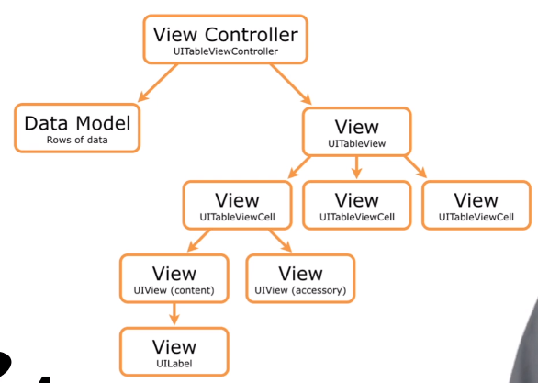

Model View Controller (MVC)

Slide 65
Create a Restaurant Data Type
Use multiple arrays to store the names, types, locations, and images of the restaurants
Let’s create a Restaurant data type using struct and let the above data be the properties of a restaurant
Then we can store multiple restaurants in an array of Restaurant objects

Slide 66
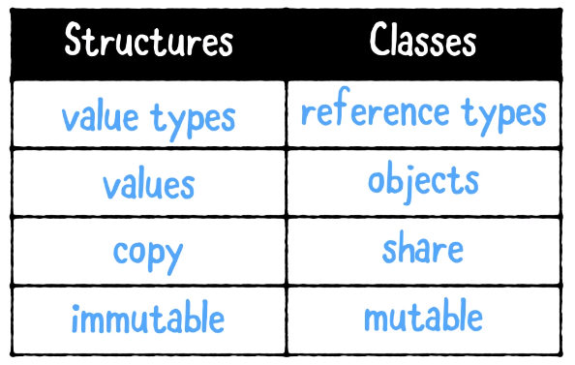
Structures and Classes

Slide 67
Create a Restaurant Struct
"New File…“ > "Swift File"
Restaurant.swift
struct Restaurant {
var name: String = “”
var type: String = “”
var location: String = “”
var phone: String = “”
var summary: String = “”
var image: String = “”
var isFavorite: Bool = false
}
Given default values
Having a default initializer
Notes:
struct Restaurant {
var name: String = ""
var type: String = ""
var location: String = ""
var phone: String = ""
var summary: String = ""
var image: String = ""
var isFavorite: Bool = false
}

Slide 68
Array of Restaurant Objects
var restaurants:[Restaurant] = [
Restaurant(name: "Cafe Deadend", type: "Coffee & Tea Shop", location: "G/F, …”, phone: “232-923423”, summary: “Searching for …", image: "cafedeadend.jpg"),
Restaurant(name: "Homei", type: "Cafe", location: "Shop B, …", phone: "348-233423", summary: "A little …", image: "homei.jpg"),
…
]
Notes:
var restaurants:[Restaurant] = [
Restaurant(name: "Cafe Deadend", type: "Coffee & Tea Shop", location: "G/F, 72 Po Hing Fong, Sheung Wan, Hong Kong", phone: "232-923423", summary: "Searching for great breakfast eateries and coffee? This place is for you. We open at 6:30 every morning, and close at 9 PM. We offer espresso and espresso based drink, such as capuccino, cafe latte, piccolo and many more. Come over and enjoy a great meal.", image: "cafedeadend.jpg"),
Restaurant(name: "Homei", type: "Cafe", location: "Shop B, G/F, 22-24A Tai Ping San Street SOHO, Sheung Wan, Hong Kong", phone: "348-233423", summary: "A little gem hidden at the corner of the street is nothing but fantastic! This place is warm and cozy. We open at 7 every morning except Sunday, and close at 9 PM. We offer a variety of coffee drinks and specialties including lattes, cappuccinos, teas, and more. We serve breakfast, lunch, and dinner in an airy open setting. Come over, have a coffee and enjoy a chit-chat with our baristas.", image: "homei.jpg"),
Restaurant(name: "Teakha", type: "Tea House", location: "Shop B, 18 Tai Ping Shan Road SOHO, Sheung Wan, Hong Kong", phone: "354-243523", summary: "Take a moment to stop and smell tealeaves! We are about the community, our environment, and all things created by the warmth of our hands. We open at 11 AM, and close at 7 PM. At teakha, we sell only the best single-origin teas sourced by our sister company Plantation directly from small tea plantations. The teas are then either cooked to perfection with milk in a pot or brewed.", image: "teakha.jpg"),
Restaurant(name: "Cafe loisl", type: "Austrian / Causual Drink", location: "Shop B, 20 Tai Ping Shan Road SOHO, Sheung Wan, Hong Kong", phone: "453-333423", summary: "A great cafe in Austrian style. We offer espresso and espresso based drink, such as capuccino, cafe latte, piccolo and many more. We also serve breakfast and light lunch. Come over to enjoy the elegant ambience and quality coffee..", image: "cafeloisl.jpg"),
Restaurant(name: "Petite Oyster", type: "French", location: "24 Tai Ping Shan Road SOHO, Sheung Wan, Hong Kong", phone: "983-284334", summary: "An upscale dining venue, features premium and seasonal imported oysters, and delicate yet creative modern European cuisines. Its oyster bar displays a full array of freshest oysters imported from all over the world including France, Australia, USA and Japan.", image: "petiteoyster.jpg"),
Restaurant(name: "For Kee Restaurant", type: "Hong Kong", location: "Shop J-K., 200 Hollywood Road, SOHO, Sheung Wan, Hong Kong", phone: "232-434222", summary: "A great local cafe for breakfast and lunch! Located in a quiet area in Sheung Wan, we offer pork chop buns, HK french toast, and many more. We open from 7 AM to 4:30 PM.", image: "forkeerestaurant.jpg"),
Restaurant(name: "Po's Atelier", type: "Bakery", location: "G/F, 62 Po Hing Fong, Sheung Wan, Hong Kong", phone: "234-834322", summary: "A boutique bakery focusing on artisan breads and pastries paired with inspiration from Japan and Scandinavia. We are crazy about bread and excited to share our artisan bakes with you. We open at 10 every morning, and close at 7 PM.", image: "posatelier.jpg"),
Restaurant(name: "Bourke Street Backery", type: "Chocolate", location: "633 Bourke St Sydney New South Wales 2010 Surry Hills", phone: "982-434343", summary: "We make everything by hand with the best possible ingredients, from organic sourdoughs to pastries and cakes. A combination of great produce, good strong coffee, artisanal skill and hard work creates the honest, soulful, delectable bites that have made Bourke Street Bakery famous. Visit us at one of our many Sydney locations!", image: "bourkestreetbakery.jpg"),
Restaurant(name: "Haigh's Chocolate", type: "Cafe", location: "412-414 George St Sydney New South Wales", phone: "734-232323", summary: "Haigh's Chocolates is Australia's oldest family owned chocolate maker. We have been making chocolate in Adelaide, South Australia since 1915 and we are committed to the art of premium chocolate making from the cocoa bean. Our chocolates are always presented to perfection in our own retail stores. Visit any one of them and you'll find chocolate tasting, gift wrapping and personalised attention are all part of the service.", image: "haighschocolate.jpg"),
Restaurant(name: "Palomino Espresso", type: "American / Seafood", location: "Shop 1 61 York St Sydney New South Wales", phone: "872-734343", summary: "We offer an assortment of on-site baked goods and sandwiches. This place has always been a favourite among office workers. We open at 7 every morning including Sunday, and close at 4 PM. Come over, have a coffee and enjoy a chit-chat with our baristas.", image: "palominoespresso.jpg"),
Restaurant(name: "Upstate", type: "Seafood", location: "95 1st Ave New York, NY 10003", phone: "343-233221", summary: "The absolute best seafood place in town. The atmosphere here creates a very homey feeling. We open at 5 PM, and close at 10:30 PM. ", image: "upstate.jpg"),
Restaurant(name: "Traif", type: "American", location: "229 S 4th St Brooklyn, NY 11211", phone: "985-723623", summary: "A young crowd populates this pork-focused American eatery in an older Williamsburg neighborhood. We open at 6PM, and close at 11 PM. If you enjoy a shared small plates dinner experience, come over and have a try.", image: "traif.jpg"),
Restaurant(name: "Graham Avenue Meats", type: "Breakfast & Brunch", location: "445 Graham Ave Brooklyn, NY 11211", phone: "455-232345", summary: "Classic Italian deli & butcher draws patrons with meat-filled submarine sandwiches. We use the freshest meats and veggies to create the perfect panini for you. We look forward to seeing you!", image: "grahamavenuemeats.jpg"),
Restaurant(name: "Waffle & Wolf", type: "Coffee & Tea", location: "413 Graham Ave Brooklyn, NY 11211", phone: "434-232322", summary: "Small shop, some seating, definitely something different! We open at 7 every morning except Sunday, and close at 9 PM. We offer a variety of waffles with choices of sweet & savory fillings. If you are gluten free and craving waffles, this is the place to go.", image: "wafflewolf.jpg"),
Restaurant(name: "Five Leaves", type: "Bistro", location: "18 Bedford Ave Brooklyn, NY 11222", phone: "343-234553", summary: " Great food, cocktails, ambiance, service. Nothing beats having a warm dinner and a whiskey. We open at 8 every morning, and close at 1 AM. The ricotta pancakes are something you must try.", image: "fiveleaves.jpg"),
Restaurant(name: "Cafe Lore", type: "Latin American", location: "Sunset Park 4601 4th Ave Brooklyn, NY 11220", phone: "342-455433", summary: "Good place, great environment and amazing food! We open at 10 every morning except Sunday, and close at 9 PM. Give us a visit! Enjoy mushroom raviolis, pumpkin raviolis, meat raviolis with sausage and peppers, pork cutlets, eggplant parmesan, and salad.", image: "cafelore.jpg"),
Restaurant(name: "Confessional", type: "Spanish", location: "308 E 6th St New York, NY 10003", phone: "643-332323", summary: "Most delicious cocktail you would ever try! Our menu includes a wide range of high quality internationally inspired dishes, vegetarian options, and local cuisine. We open at 10 AM, and close at 10 PM. We welcome you into our place to enjoy a meal with your friends.", image: "confessional.jpg"),
Restaurant(name: "Barrafina", type: "Spanish", location: "54 Frith Street London W1D 4SL United Kingdom", phone: "542-343434", summary: "a collection of authentic Spanish Tapas bars in Central London! We have an open kitchen, a beautiful marble-topped bar where guests can sit and watch the chefs at work and stylish red leather stools. Lunch starts at 1 PM. Dinners starts 5:30 PM.", image: "barrafina.jpg"),
Restaurant(name: "Donostia", type: "Spanish", location: "10 Seymour Place London W1H 7ND United Kingdom", phone: "722-232323", summary: "Very good basque food, creative dishes with terrific flavors! Donostia is a high end tapas restaurant with a friendly relaxed ambiance. Come over to enjoy awesome tapas!", image: "donostia.jpg"),
Restaurant(name: "Royal Oak", type: "British", location: "2 Regency Street London SW1P 4BZ United Kingdom", phone: "343-988834", summary: "Specialise in great pub food. Established in 1872, we have local and world lagers, craft beer and a selection of wine and spirits for people to enjoy. Don't forget to try our range of Young's Ales and Fish and Chips.", image: "royaloak.jpg"),
Restaurant(name: "CASK Pub and Kitchen", type: "Thai", location: "22 Charlwood Street London SW1V 2DY Pimlico", phone: "432-344050", summary: "With kitchen serving gourmet burgers. We offer food every day of the week, Monday through to Sunday. Join us every Sunday from 4:30 – 7:30pm for live acoustic music!", image: "caskpubkitchen.jpg")
]

Slide 69
Fix Errors
configureDataSource()
<Section, String> → <Section, Restaurant>
cellProvider: restaurantName → restaurant //one object from the restaurants array
Cell configure: restaurant.name, restaurant.location, restaurant.type, …
NSDiffableDataSourceSnapshot in viewDidLoad
<Section, String> → <Section, Restaurant>
appendItems(restaurants, …) //pass the entire source array

Slide 70
Fix Errors
tableView(_:disSelectRowAt)
self.restaurants[indexPath.row].isFavorite
Restaurant.swift
struct Restaurant: Hashable { … } //for the comparable reason
All value-based types conform to the hashable protocol

Slide 71
Organize Project Files
Organize the files by group/folder
Group them by their responsibilities in MVC
Right click the FoodPin folder and select New Group
Create three groups
Controller: TableViewController.swift
Model: Restaurant.swift
View: TableViewCell.swift

Slide 72
Document and Organize Swift Codes
Use comment markers
// MARK: - View controller life cycle
override func viewDidLoad() { … }
override func didReceiveMemoryWarning() { … }
// MARK: - UITableViewDataSource Protocol
override func numberOfSections(in tableView: UITableView) -> Int { … }
override func tableView(_ tableView: UITableView, …) -> Int { … }
MARK: - With a separator line
MARK: Without a separator line
Notes:
// MARK: - View controller life cycle
// MARK: - UITableViewDataSource Protocol

Slide 73
Document and Organize Swift Codes
Click the jump bar on top of the editor window

Slide 74
Improve the Data Model
Remove the initial data setting to the data model file
Restaurant.swift
static func generateData( sourceArray: inout [Restaurant]) {
sourceArray = [
Restaurant(…),
…
]
}
TableViewController.swift
var restaurants:[Restaurant] = []
(viewDidLoad) Restaurant.generateData(sourceArray: &restaurants)
Notes:
//Array is a value-type object
extension Restaurant {
static func generateData( sourceArray: inout [Restaurant]) {
sourceArray =
}
}

